Slide 1
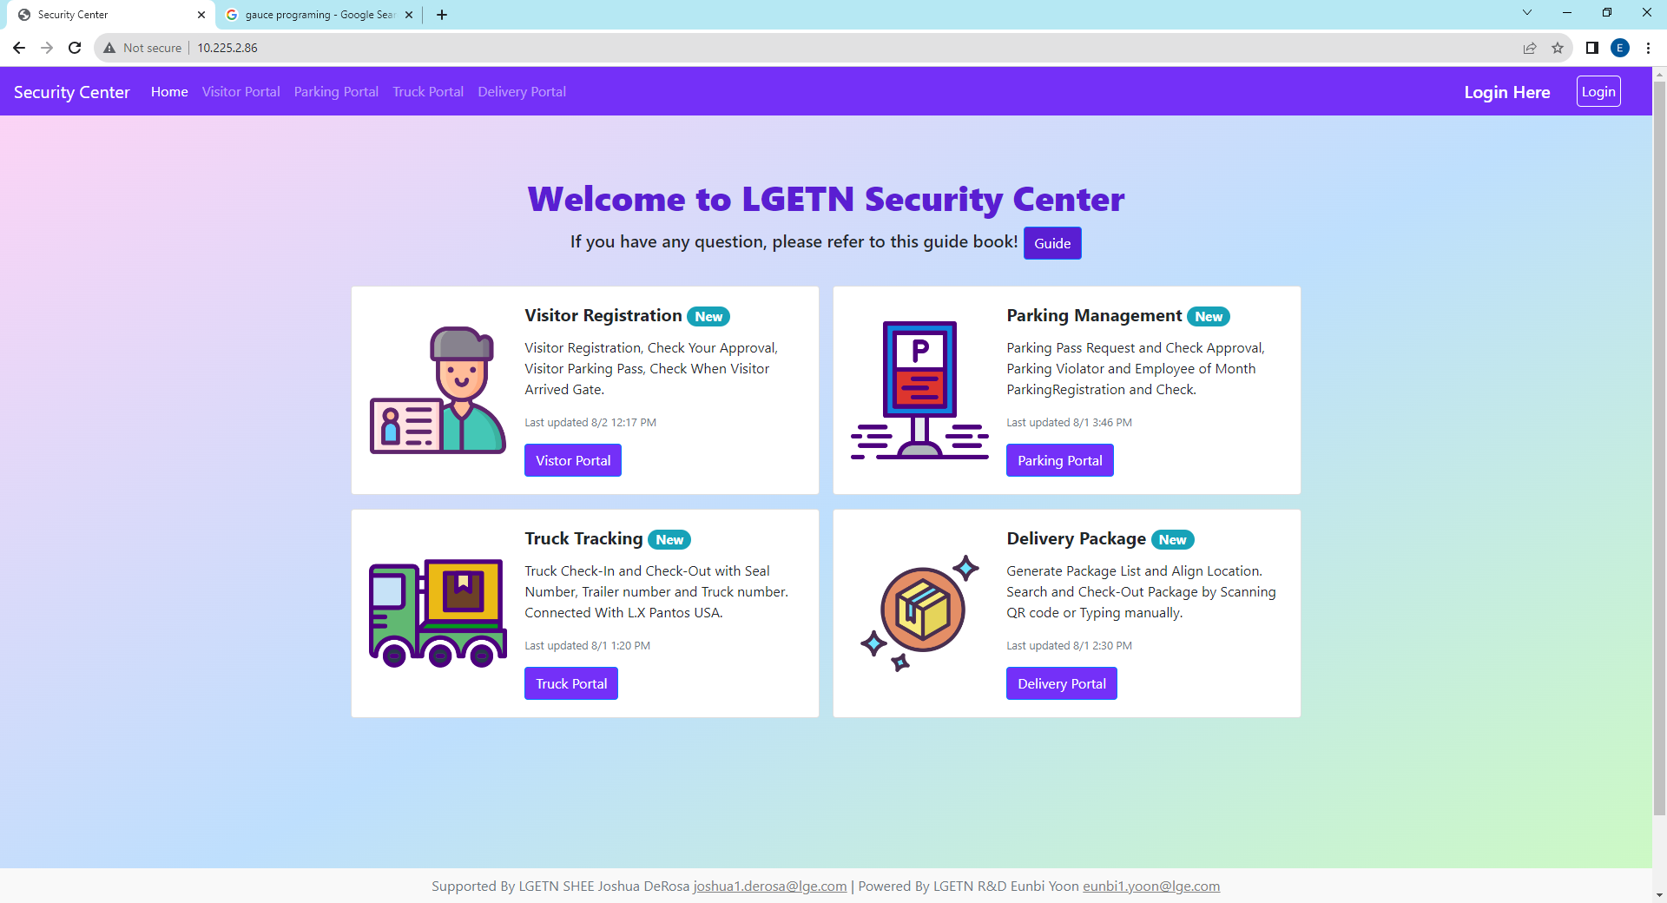
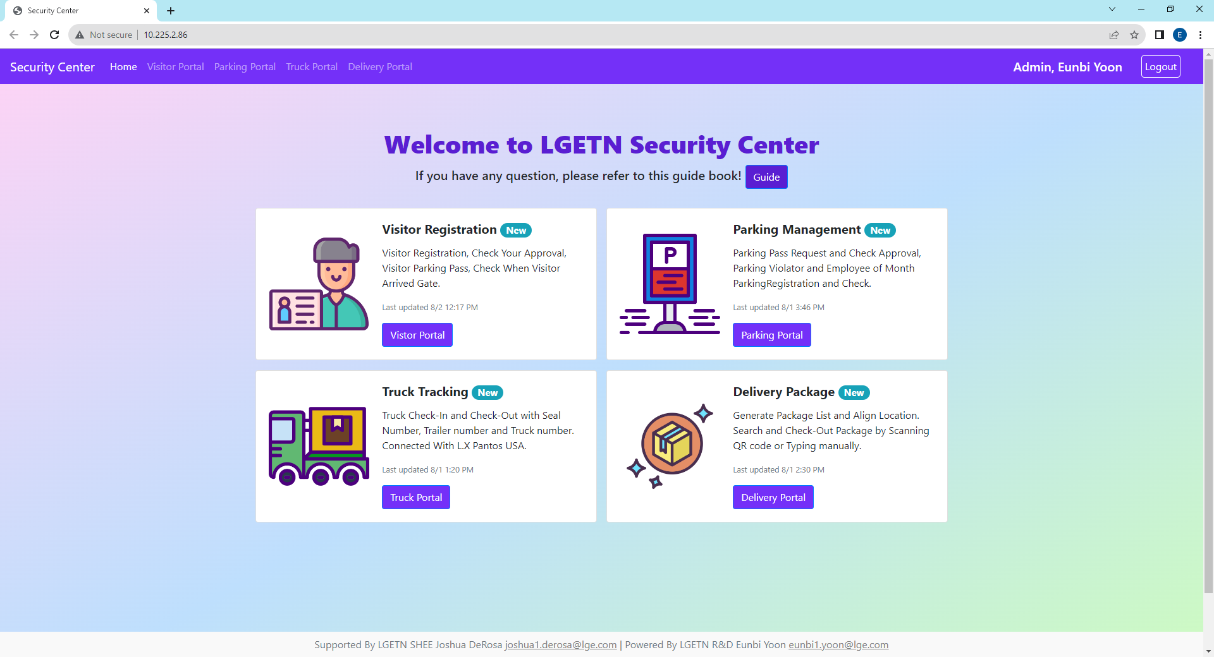
0. Security Center Main
You should log in to access this website and if you are logout it when you click some buttons to move page you will connect to login page automatically
When you log in, it shows your authority, First and Last name on the Top Right side
Website has two types of accounts authority, Admin and User. User Authority is approval requester and Admin Authority is approver, usually security member
Map
Admin Location
Function
Manager
Security Building Manager,
SHEE Team PIC, Developer
Visitor Portal
Security Building
Visitor Registration, Visitor Parking Pass
Account
Admin
Security Building Staff,
Security Gate2 Staff
Parking Portal
Security Building,
Gate2 Security
Parking Pass Request, Parking Violator,
Employee of Month
Security Center
User
LGETN All Member
Truck Portal
Gate2 Security
Truck Check-In, Out
inked with LX Pantos USA.
Delivery Portal
Security Building
Generate Package List to Search and Check-Out Package
Log-Out
Log-In
Click the Login Button
Authority, FirstName LastName

Slide 2
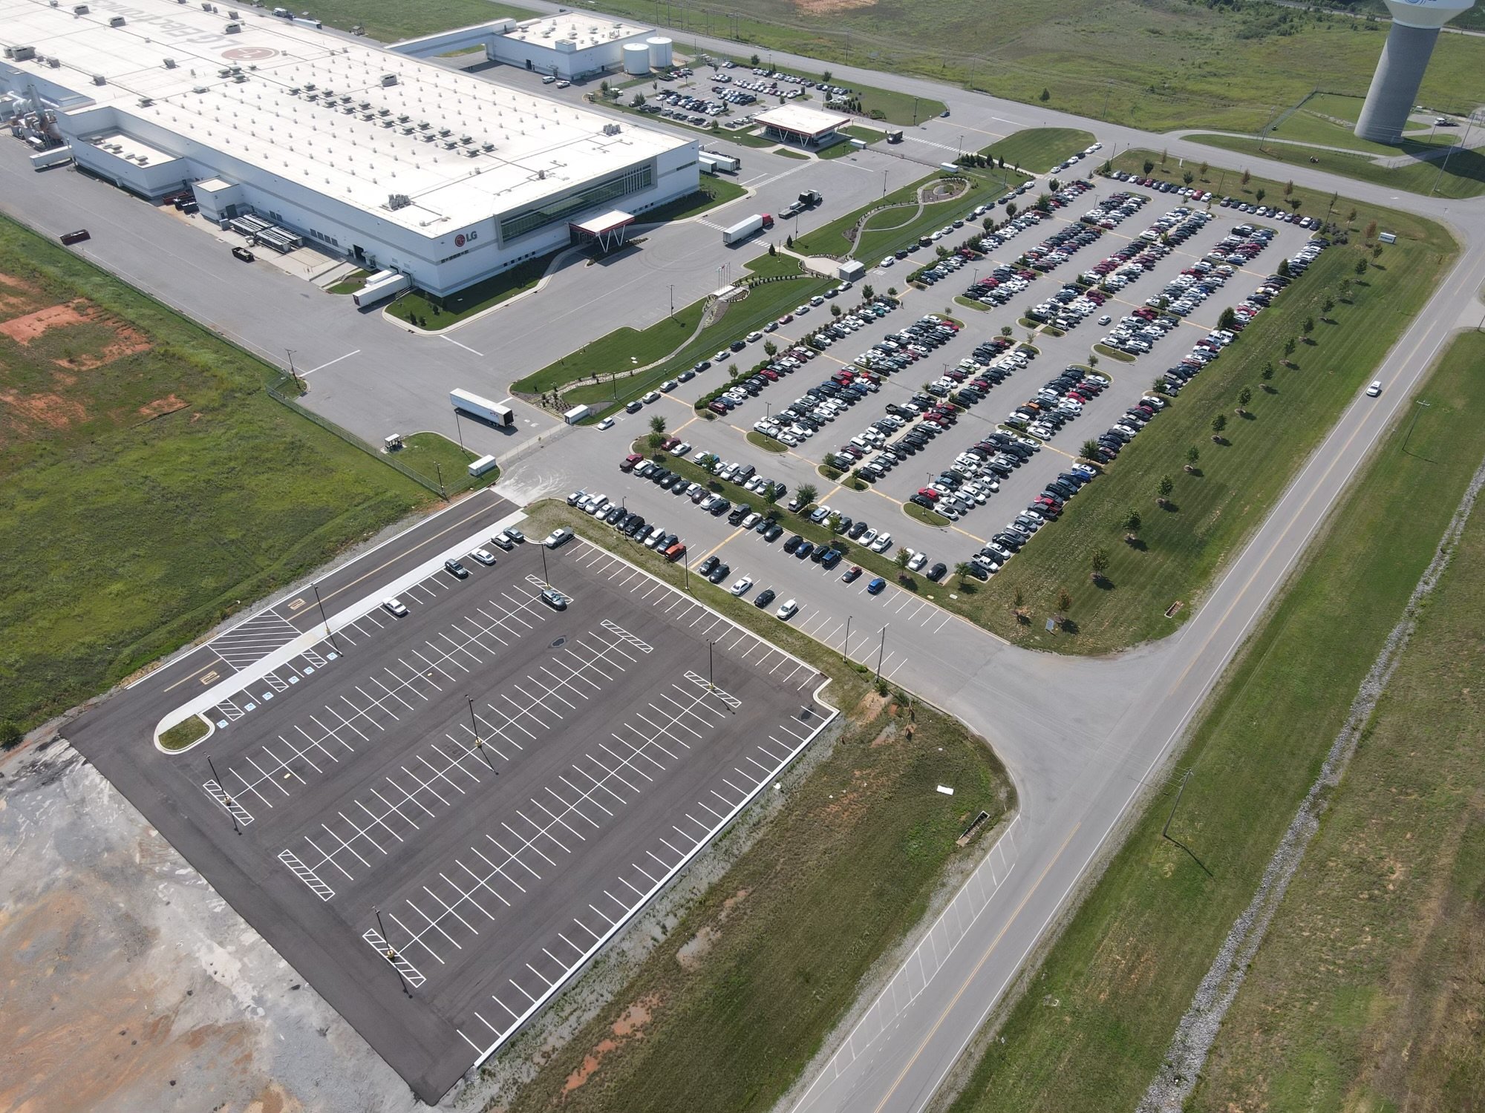
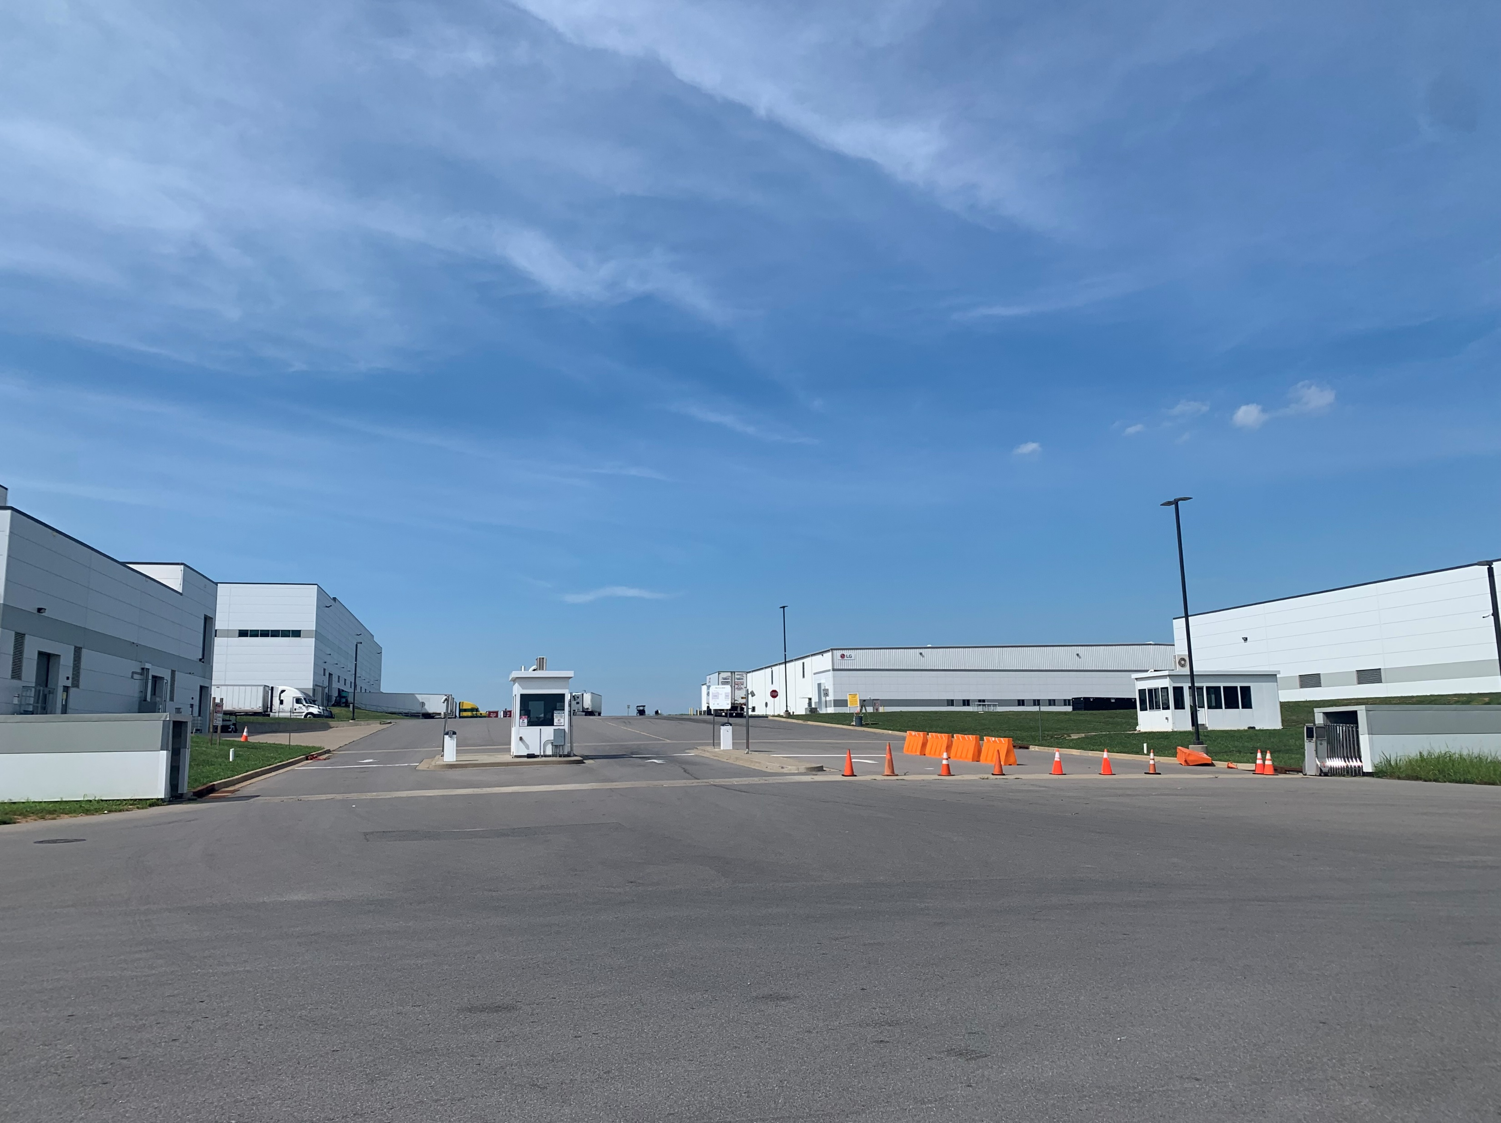
Appendix. Admin Location
Security Building
Gate2 Security

Slide 3
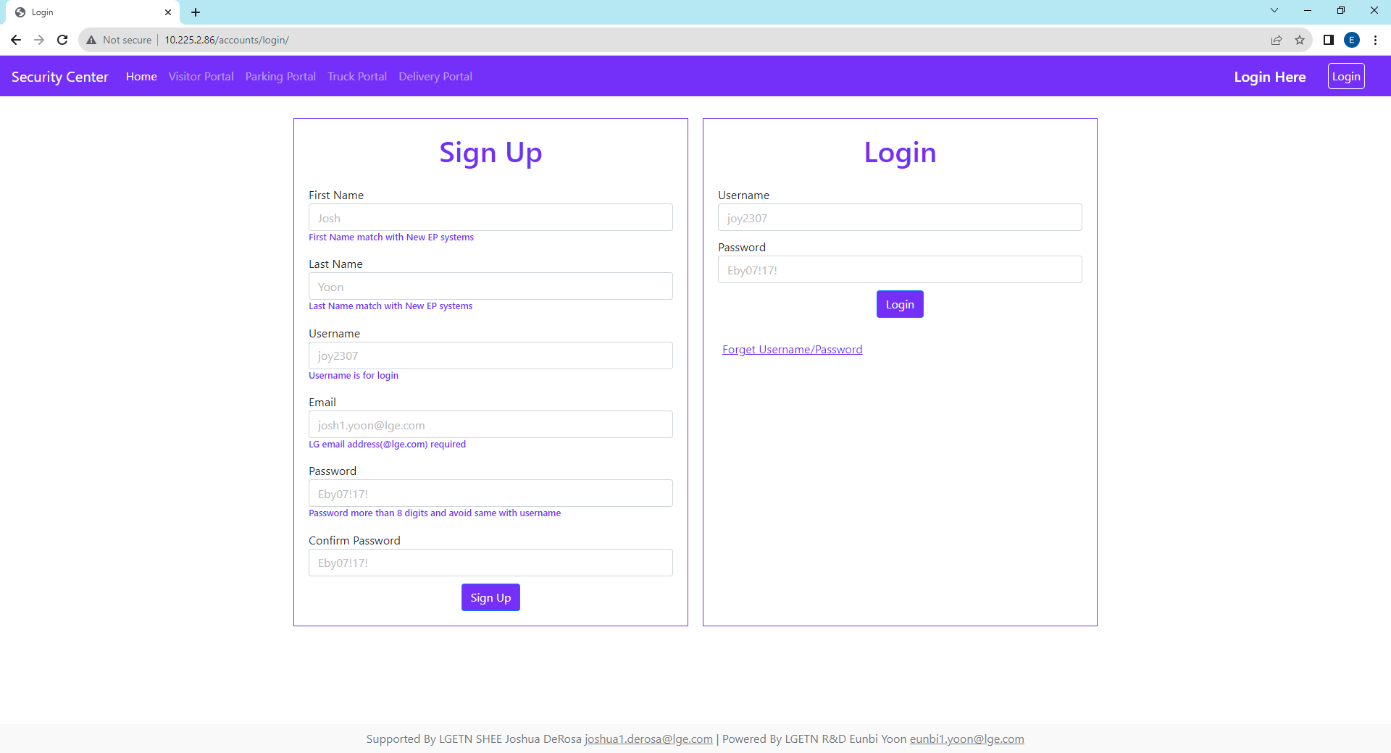
1. Sign Up, Log In Page
When you sign up here, you will get User Authority, however if you need Admin Authority then send your all sign up information referring to this page sign-up form to email (eunbi1.yoon@lge.com)
When you sign up, all blanks are required to fill out and check all requirements below the blanks.
Do not make password same with username. e.g. username : user, password : user1357(X).

Slide 4
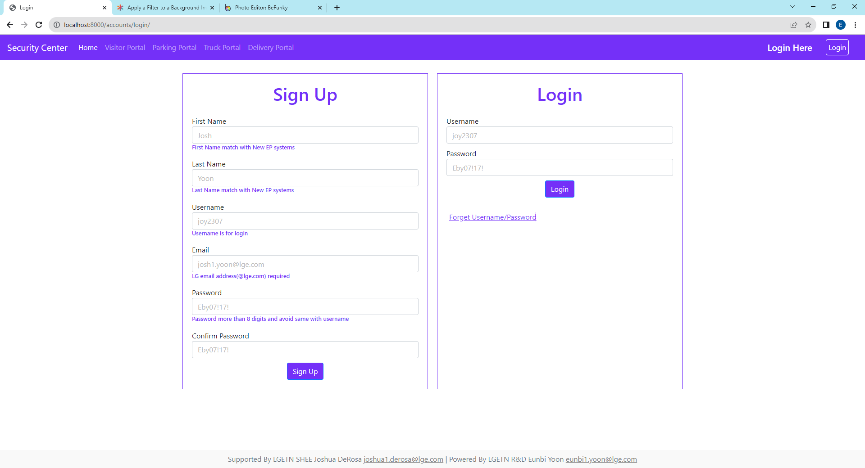
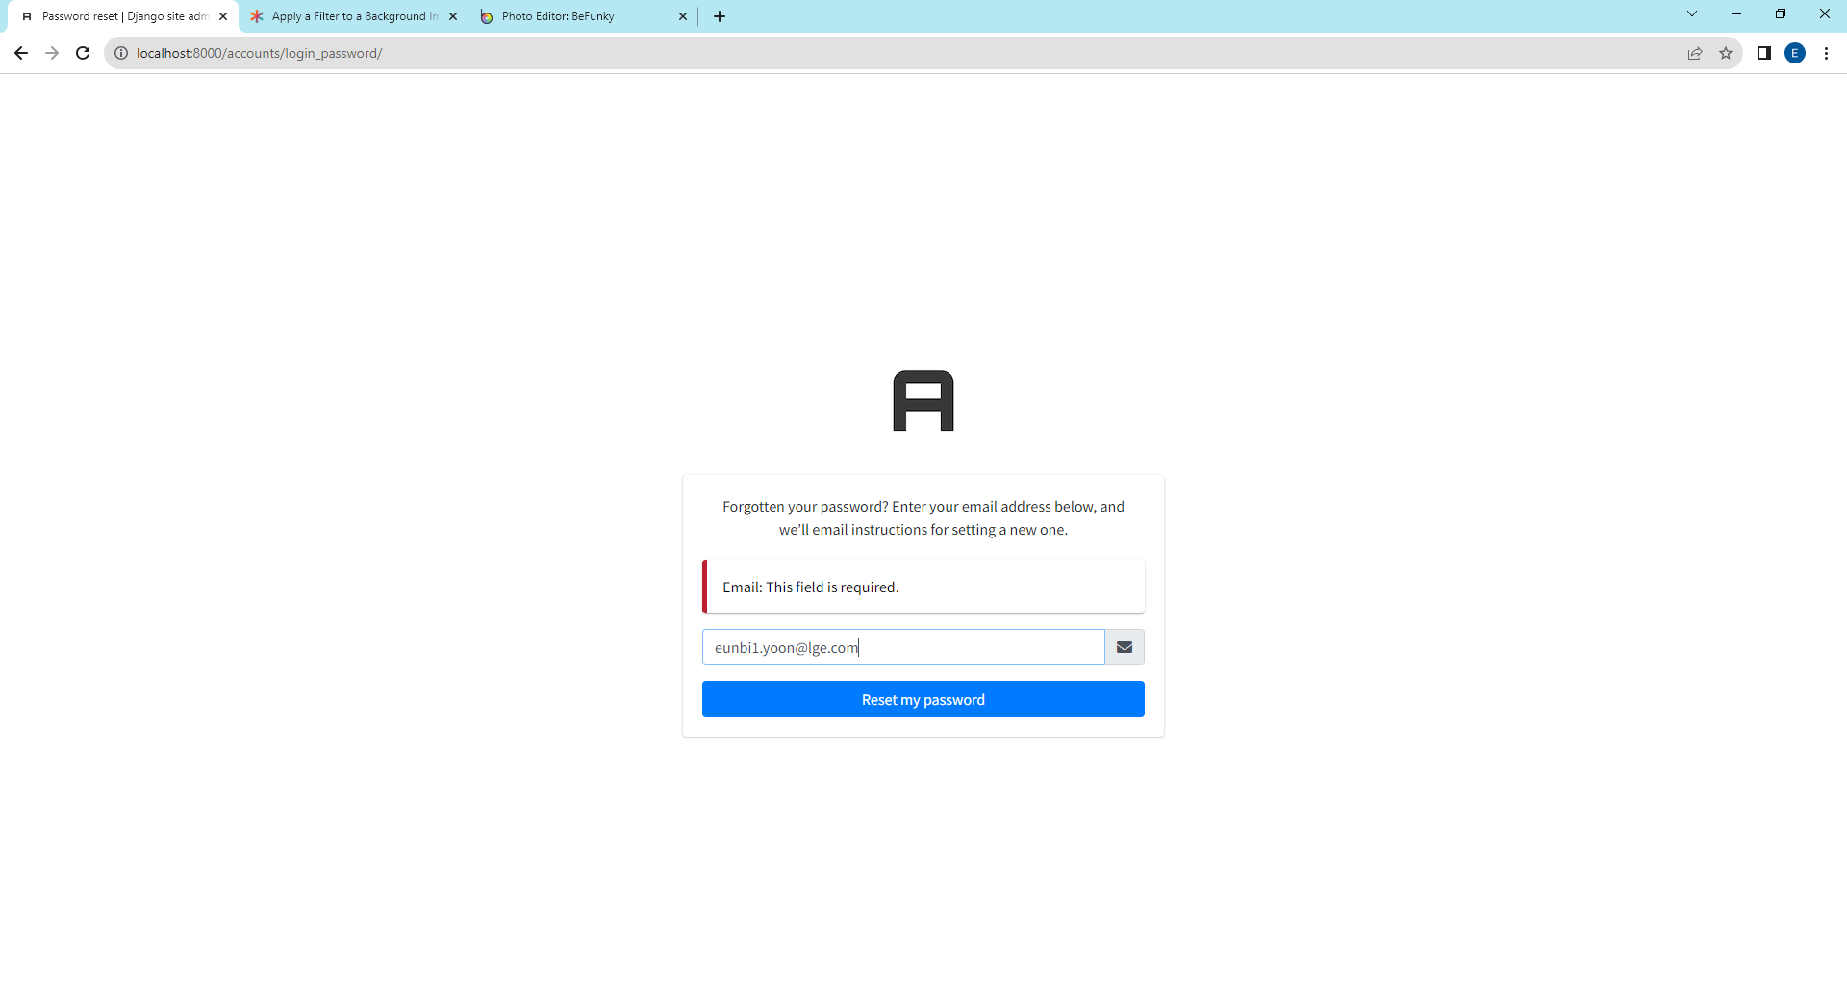
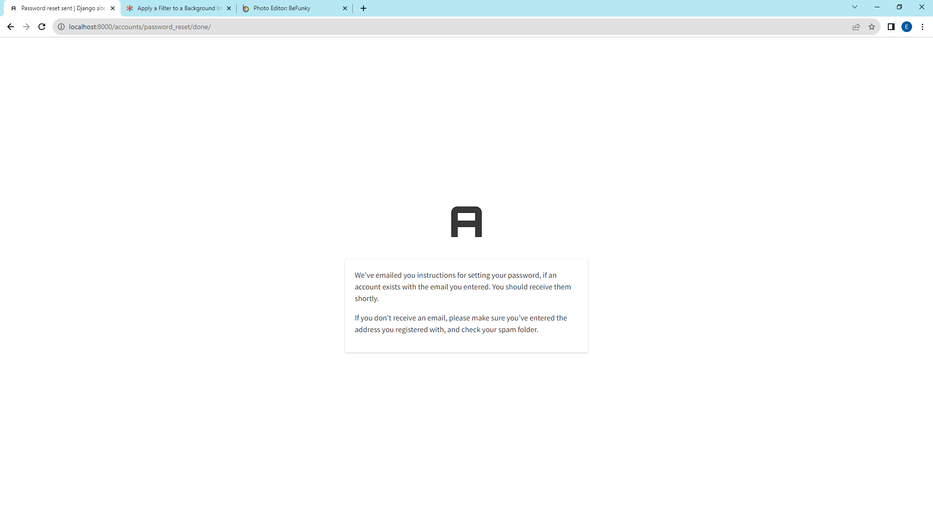
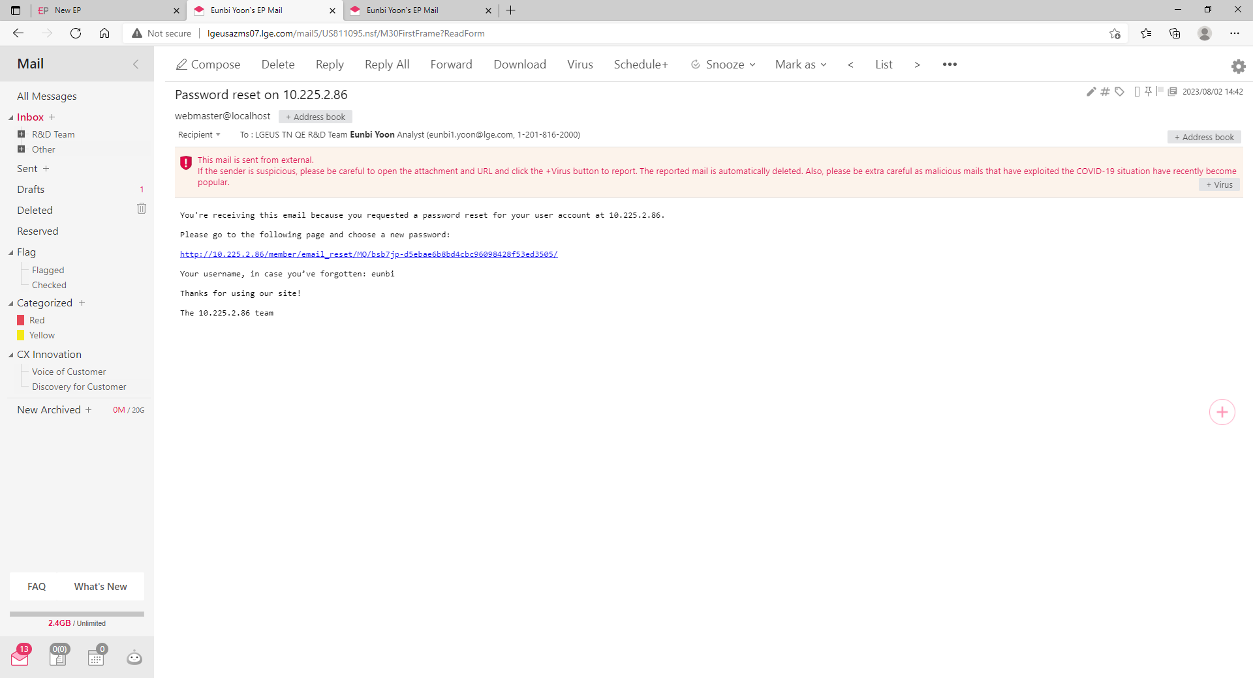
1. Sign Up, Log In Page - Forget Username/Password
If you forget password or username, please click “Forget Username/Password”. You will receive email showing username and password reset link.
Click the link
1
2
Click to send password reset link and username information to your email
It should be matched with LG email that you fill when sign up.
After this, click reset my password
3
4
Subject Line: Password reset on 10.225.2.86
Password can be reset if you click this link
You can check your username
Check email sending confirmation message

Slide 5
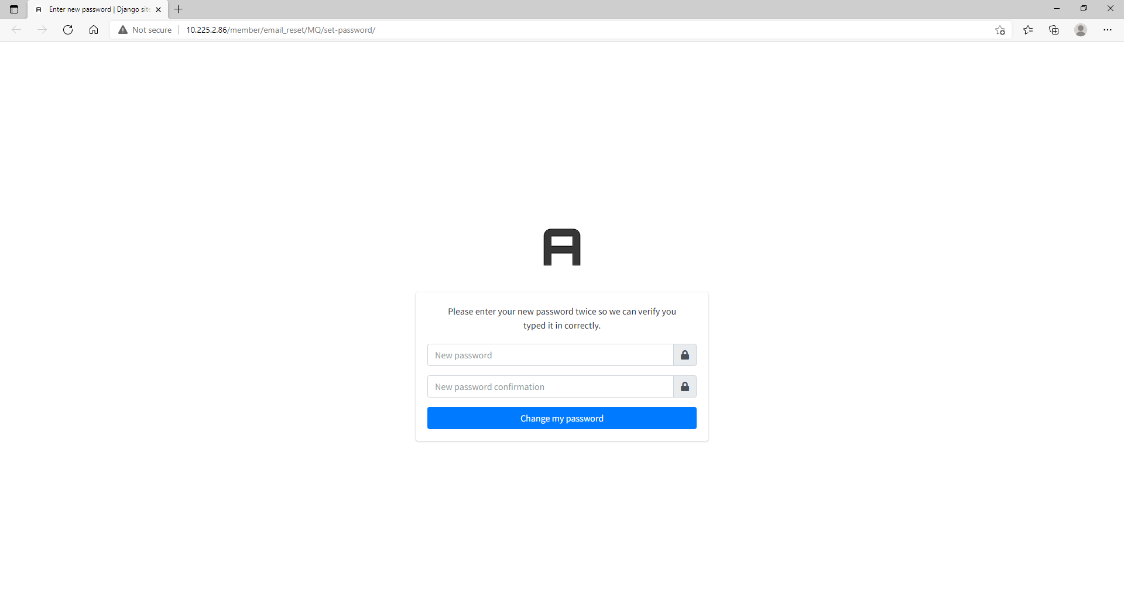
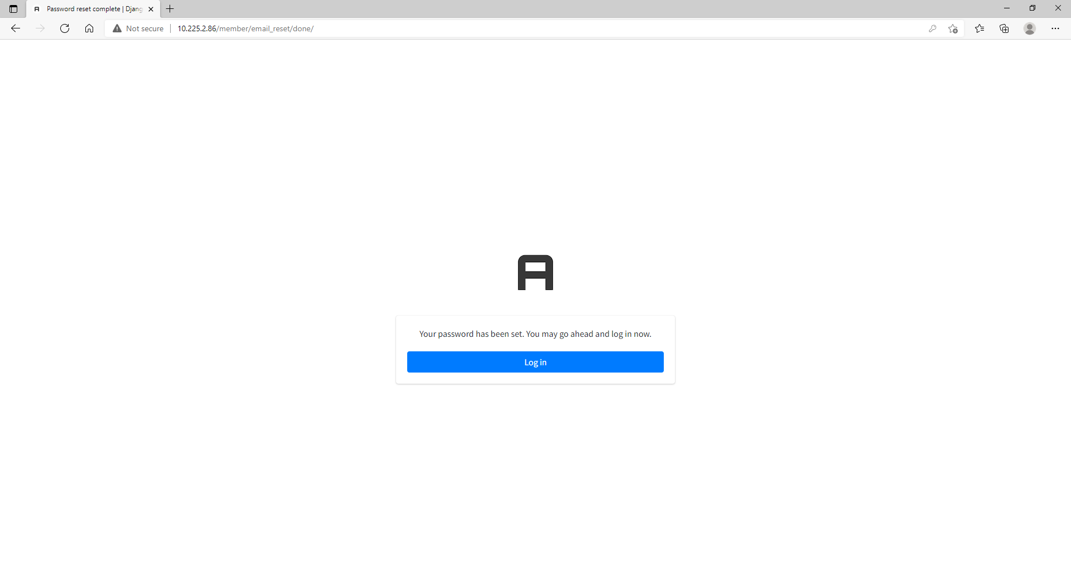
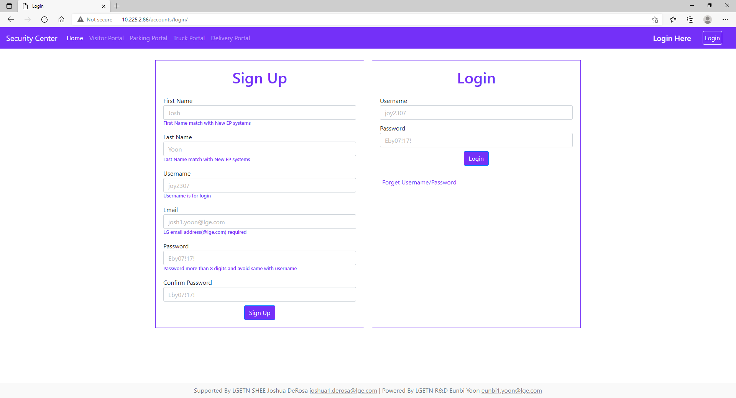
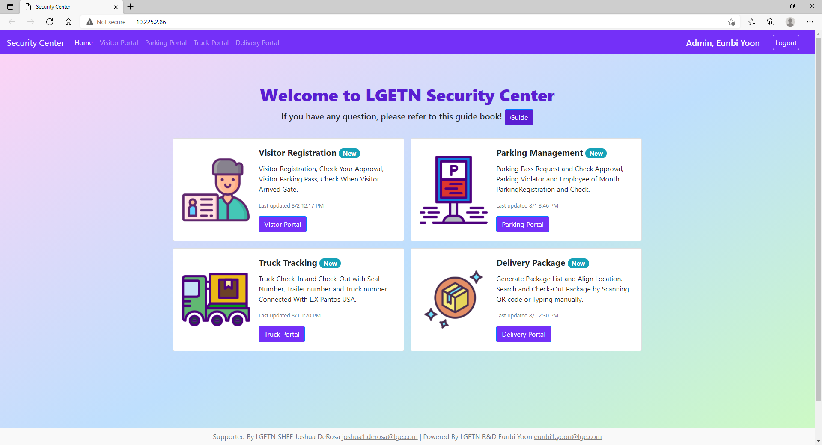
1. Sign Up, Log In Page - Forget Username/Password
If you forget password or username, please click “Forget Username/Password”. You will receive email showing username and password reset link.
When you enter email address to reset your password, it should be LG Email(@lge.com) and match with email address that you sign up.
5
6
Enter New Password
Click the link to go to login page
7
8
Successfully login to your account
Login with new password

Slide 6
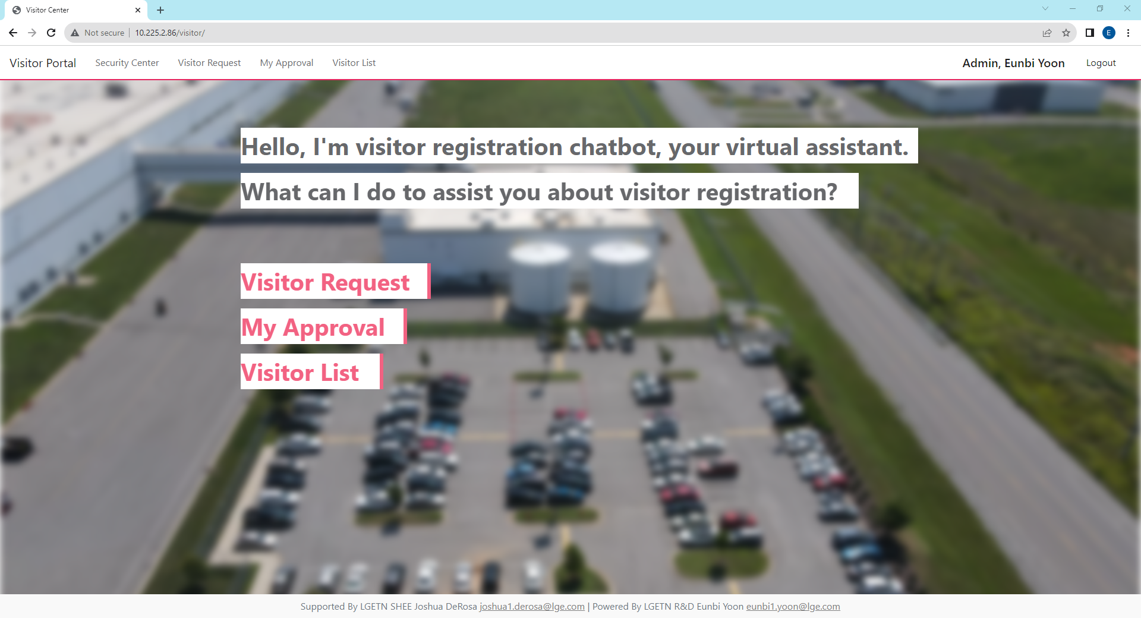
2. Visitor Portal - Main
When you have visitor, you can use this portal to request visitor and get approval from security admin.
According to company rules, even though you get approval in here, when visitors move their locations, visitor PIC should be with visitors all the time.
The main page is operating like chatbot so if you want to move to your request fast please use quick menu located on the top of all web pages.
In the quick menu, security center
Quick Menu
Users Request Visiting Non-LGETN Member
Users Check their Visitor Request Approval.
All Users need Security Admin Approval about their requests
When Visitor come in and out Security Gate, Security Admin will check-in and check-out

Slide 7
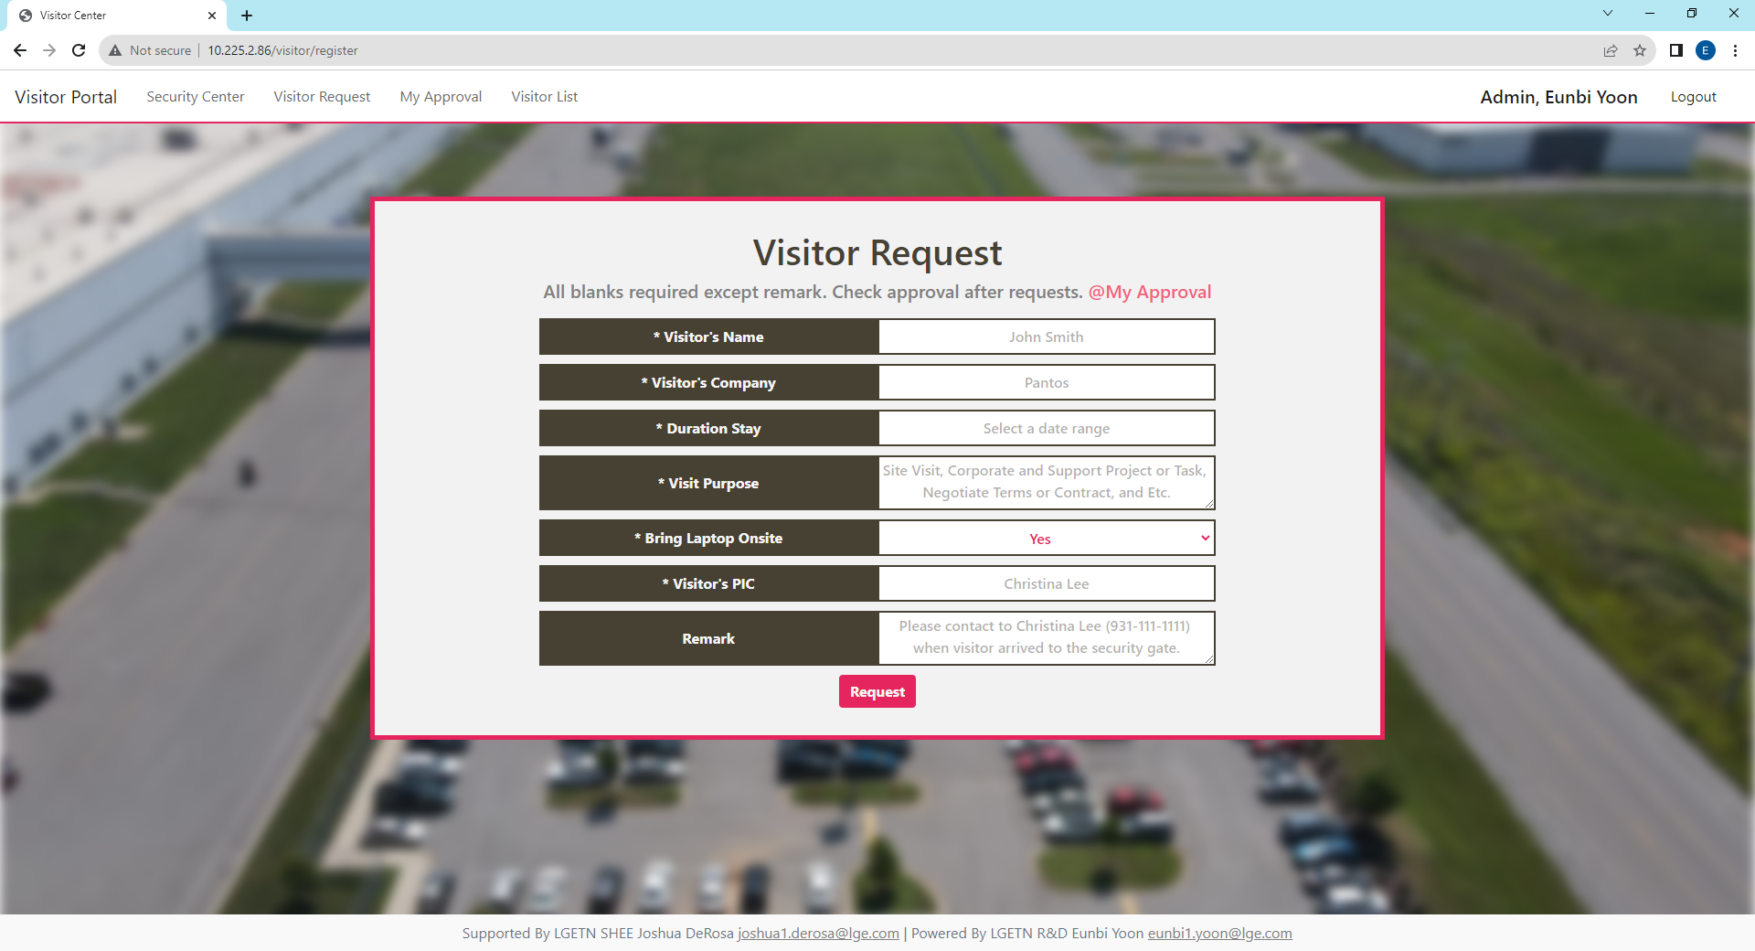

2. Visitor Portal - Visitor Request
All blank is required to fill, except remark section. Each blank example shows as placeholder so please refer to those.
You can register several visitor in one request and please describe each blanks as much as detailed.
If visitors bring laptop, they should download LGETN security program in the security building before access to the building.
If you remained your contact number, then security will try to call you when the visitor arrived in security building.
Example : Placeholder

Slide 8
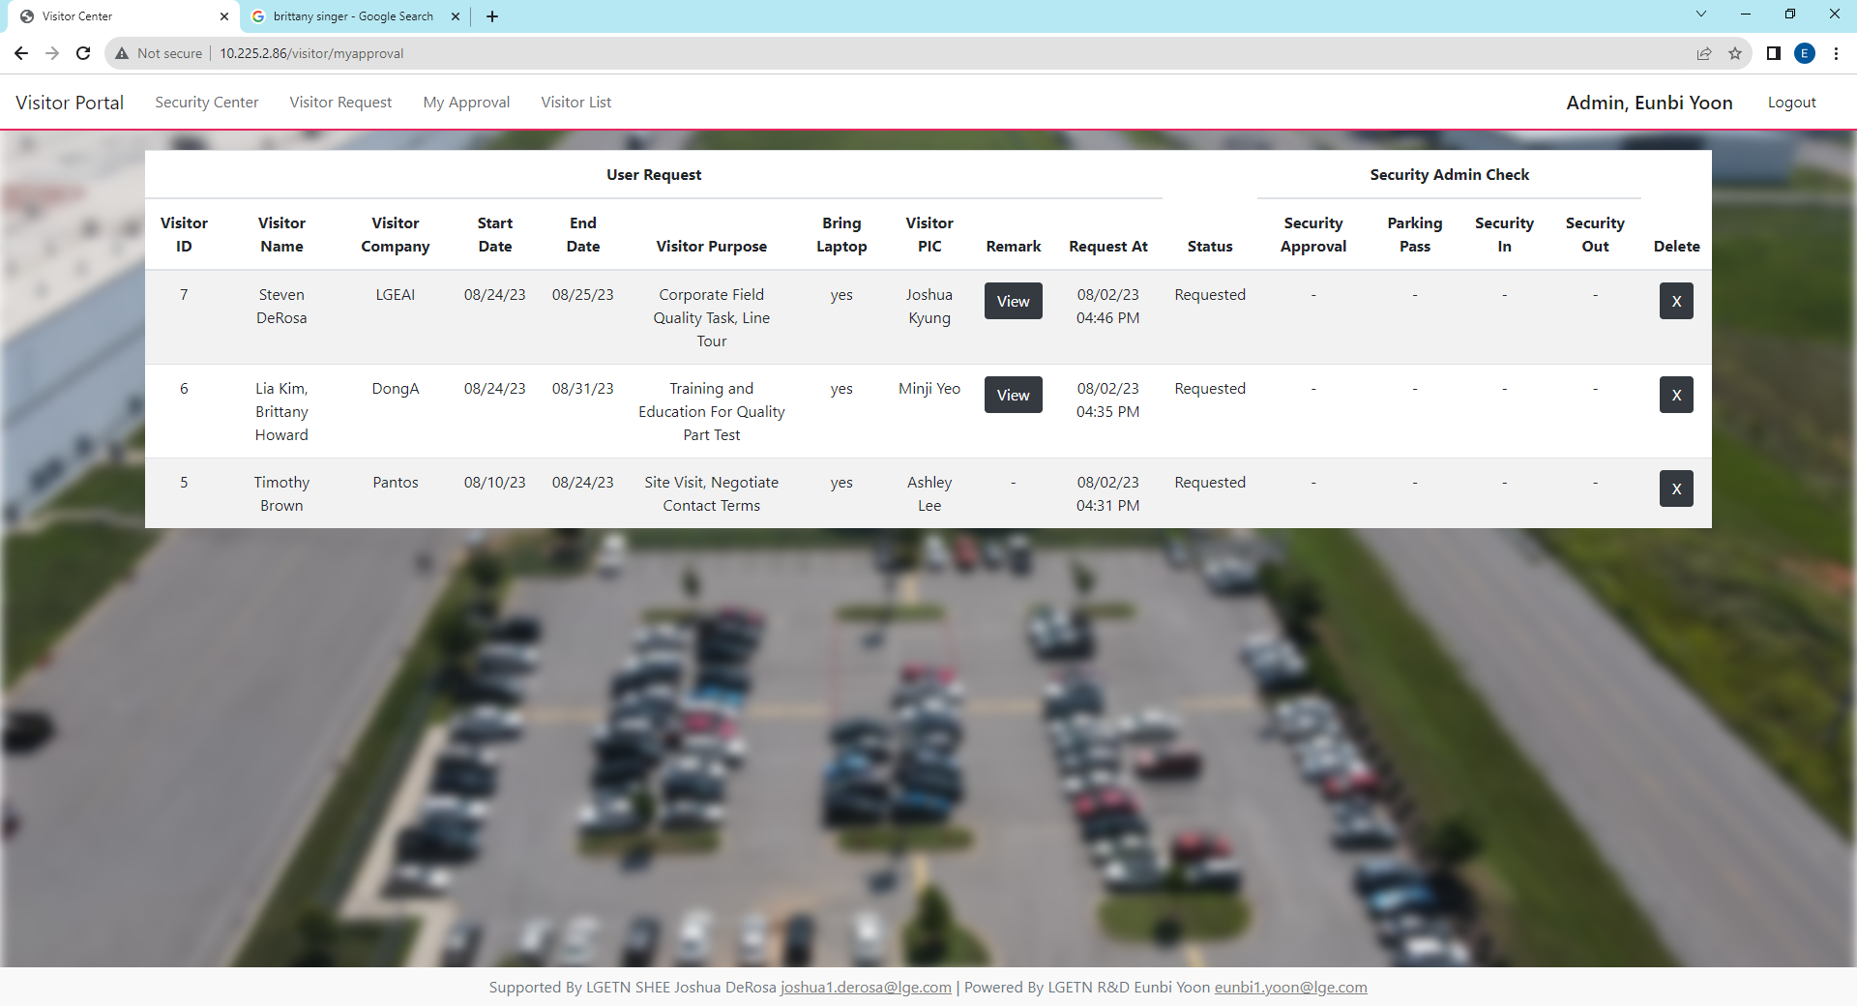
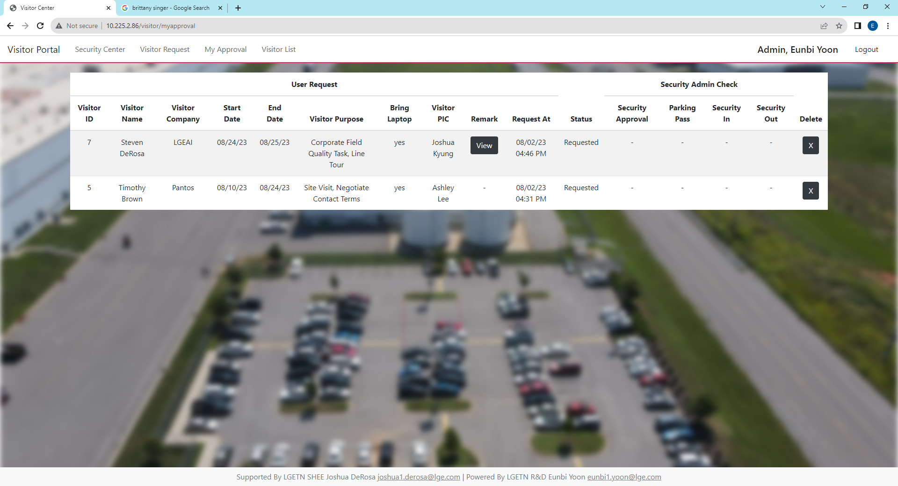
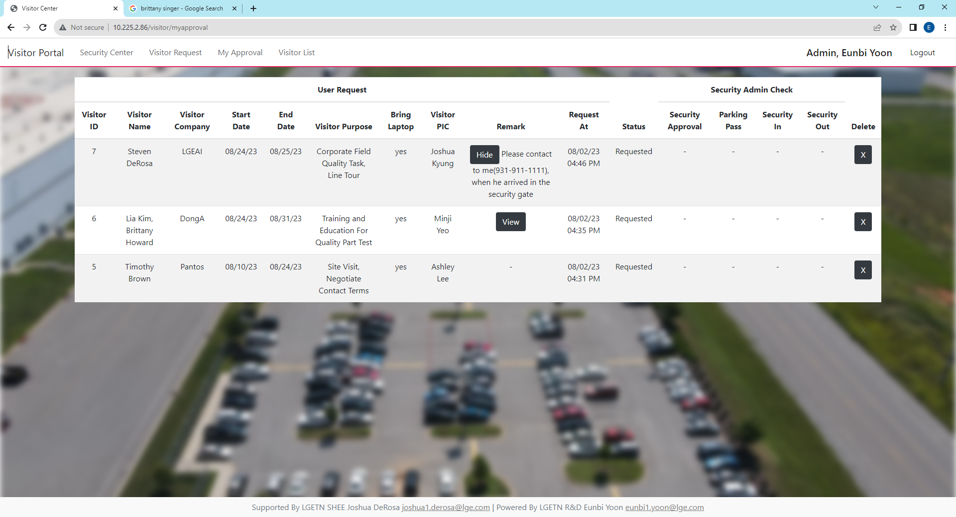

2. Visitor Portal – My Approval
After you request visitor, it directly move to my approval and you can see only your request order by recent request time.
If you don’t have remark, it described as “-” and if you have it shows view button. You can also hide the text when you click the hide button.
You can delete your request anytime you want even though the security admin approve your request.
Main
Delete(X) Button
View Button
Hide Button
View Button show the remark.
If there is no view button, it means you did not make a remark.

Slide 9
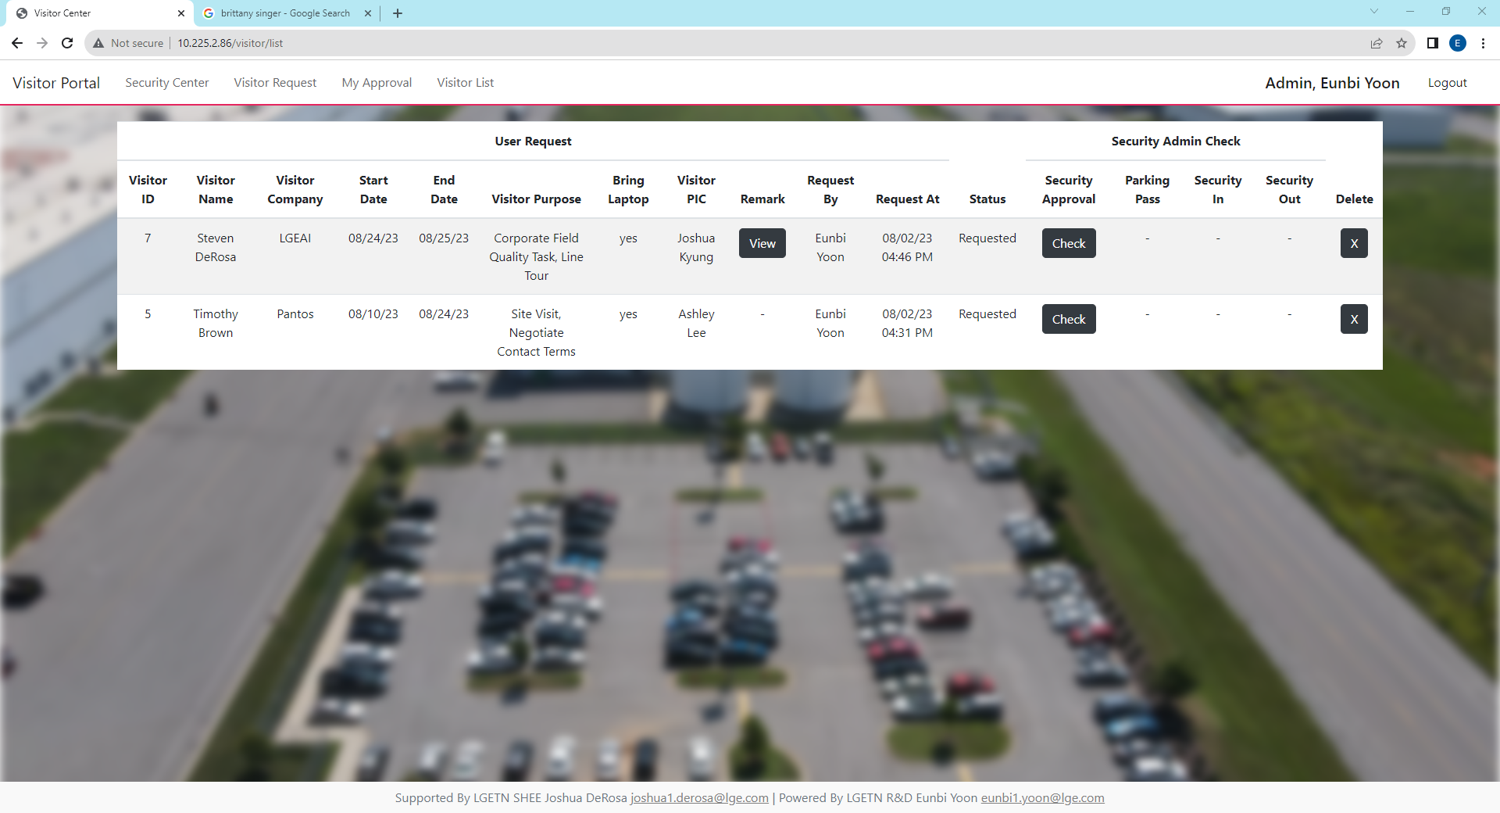
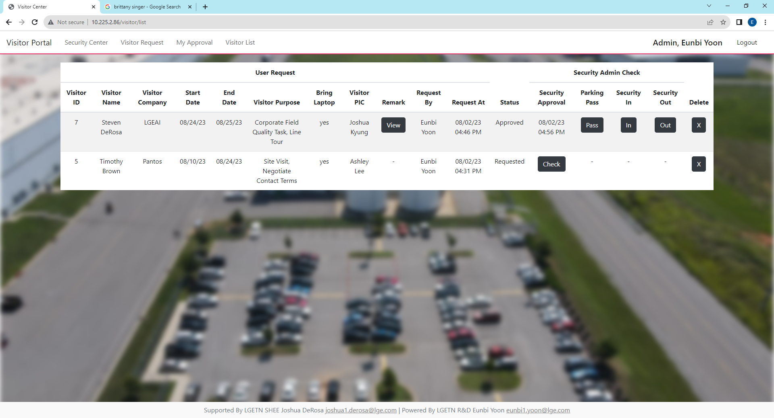
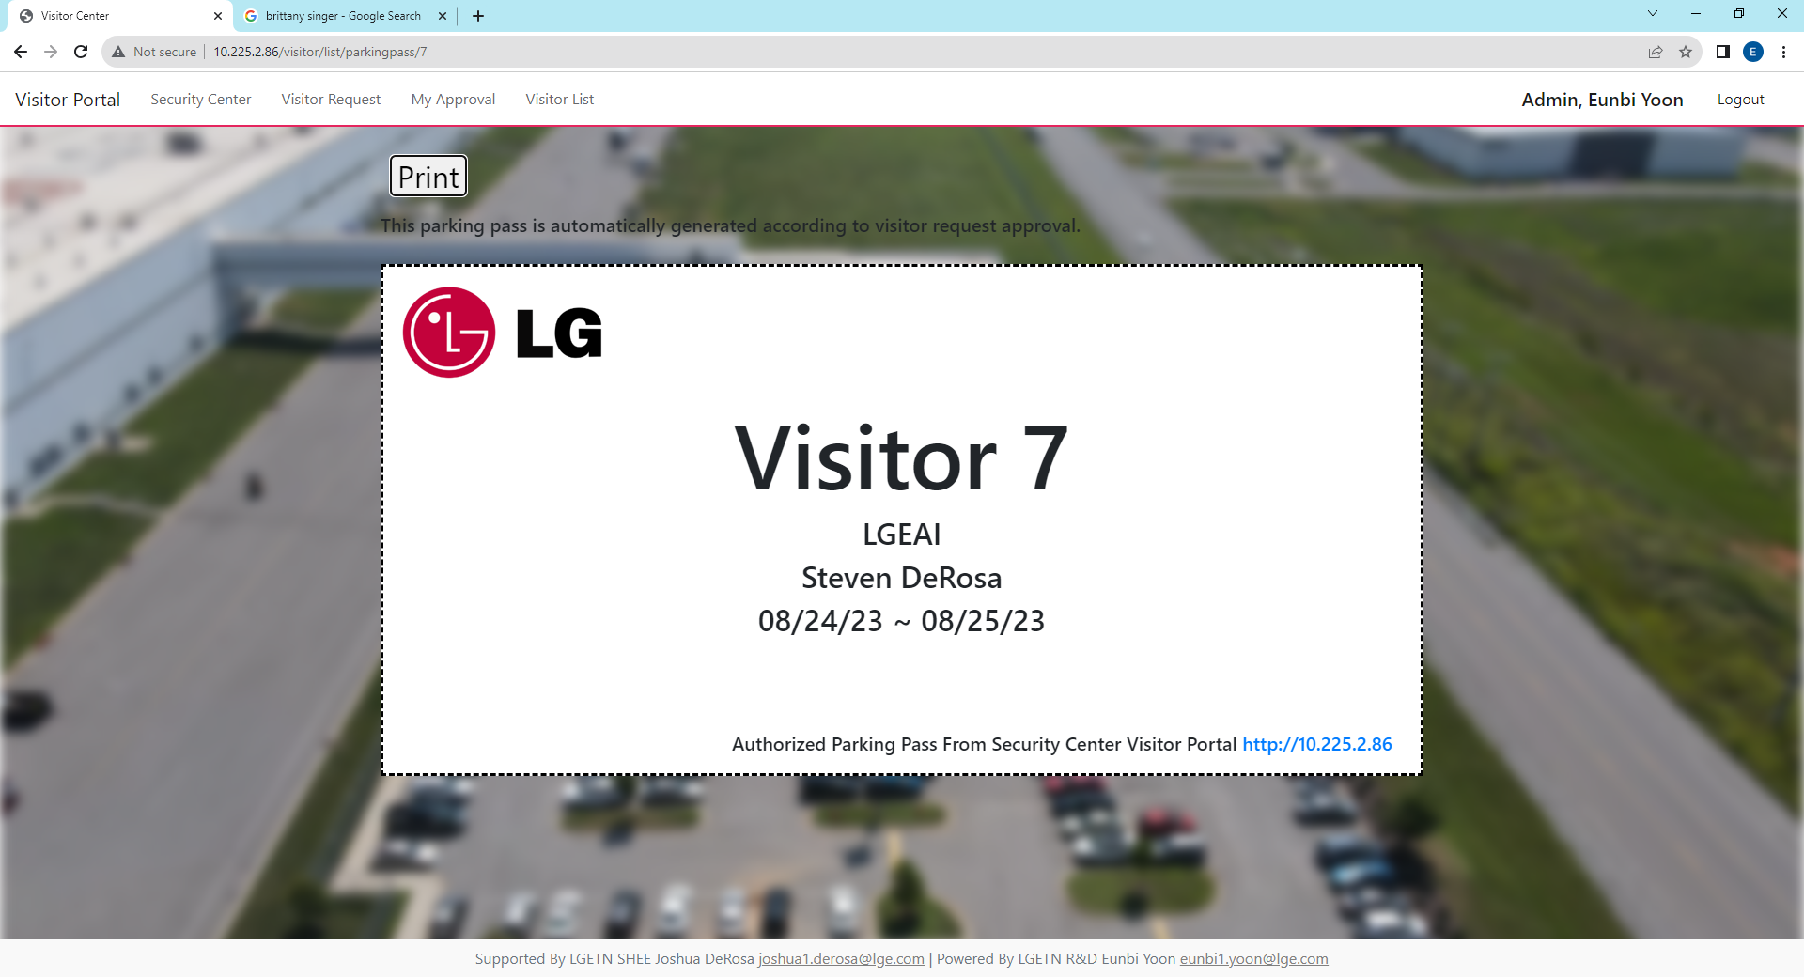

2. Visitor Portal – Visitor List
If you want to see all visitor list, please move to visitor list using quick menu on the top of the website.
View, Hide and Delete button function is same as My Approval.
When admin check user approval, admin click the Check Button. If admin doesn’t want to approve, please delete the request with Delete Button..
1
2
Approve
Check Button
Parking Pass,
Security In, Out Active
When Admin approve Security Approval,
1) Security Approval is filled with when it approved
2) All accounts can see parking pass
3) Admin can security in and out when visitor arrived
4) Admin can delete request
Admin
Reject
Delete(X) Button
Delete Request
3
This is Parking Pass and press button for print.
User or Admin can provide parking pass to visitor
4
When visitor arrived and left to security building,
Admin click “Security-In” and “Security-Out”.
If remark exists, Admin check remark and call requested number.
*Visitor should put parking pass at windshield.*
Parking Pass has following information
Visitor ID, Visitor Company, Visitor Name, Duration Stay

